Slide 1
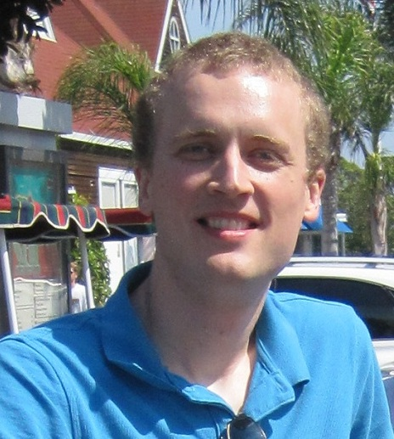
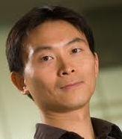


“Robust protocols for securely expanding randomness
and distributing keys using untrusted devices”
by Carl A. Miller and Yaoyun Shi
“Physical Randomness Extractors”
by Kai-Min Chung, Yaoyun Shi, and Xiaodi Wu

Slide 2
Outline
y
-xy
Introduction
The Framework of Untrusted-Device Extraction.
Our results
Proof Techniques: Miller-Shi
Proof Techniques: Chung-Shi-Wu
Further Directions
x
… 10110 11101101000010010001111101001001001001111010100 ….
… 01001 00010010111011011101111010010000100000011101111 ….
11011 1010010001011101010001011101101010001111111010100010 ….

Slide 3

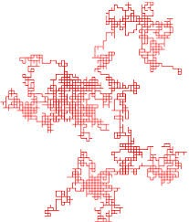
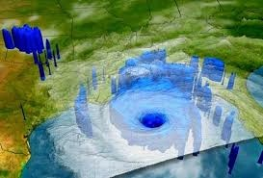

Randomness! We need it.
The number of random bits used
every day is probably in the trillions.
* Digital security.
* Randomized algorithms.
* Scientific simulations.
* Gambling.

Slide 4
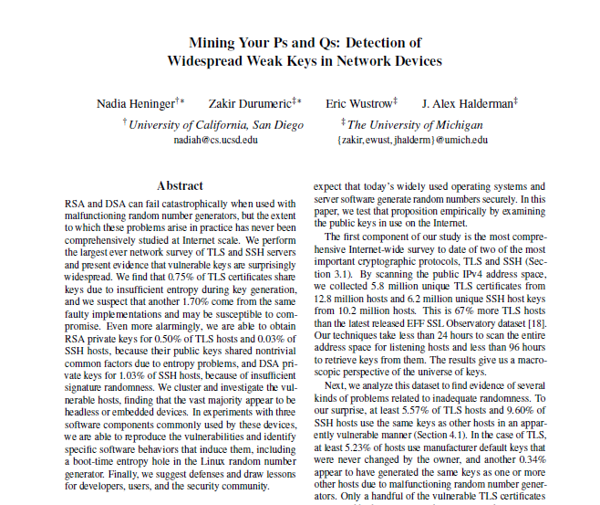

We are not always getting it ….
Heninger et al. broke the
keys of many SSH hosts
by exploiting insufficient
randomness.

Slide 5
We are not always getting it ….
From the introduction:
“Ultimately the results of our
study should serve as a wake-up
call that secure random number
generation continues to be an
unsolved problem in important
areas of practice.”

Slide 6

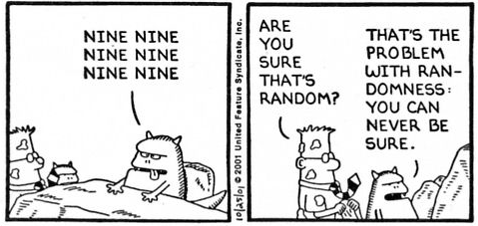
How do we know when it’s random?

Slide 7
Randomness extraction
Turn weak sources of randomness into true randomness
Model a weak source by a bit string of min-entropy
(n, k)-source: n-bit strings that can be guessed with at most 2^{-k} chance
A beautiful theory developed since 1980’s, still an active field of research in computer science
Many ingenious, powerful constructions
Deterministic
… 1001001111100100110010100011101001 0011010111010101011 ….
… 01001 0001001011101101110111101001 0110110010110101011 ….

Slide 8
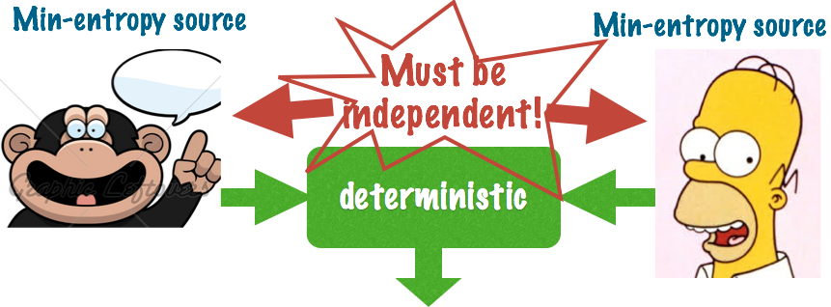
Limitations of the classical theory
Deterministic extraction (=single source) is impossible
SV source: x₁,x₂,…,x_{n},…,each bit x_{i} has a bounded bias conditioned on previous bits
Highly random: linear min-entropy
Can’t even extract 1 bit of true randomness
Two independent sources are required!
All two-source extract fail to extract 1 bit on some constant-bit correlated sources
Impossible to check independence!

Slide 9
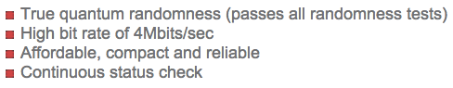
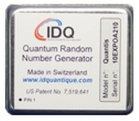
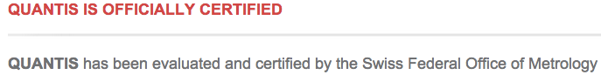
Quantum solution?
Q. theory has true randomness in its postulates
Used in theoretical constructions (e.g., in QKD.)
Commercial products available

Slide 10
At the cost of trust …
As classical beings,we can’t feel quantum
Noise: need to believe that the device isn’t faulty.
Trust: need to believe that the hardware is trustworthy. (For QKD, this is especially hard.)

Slide 11
Untrusted Quantum Devices
The Central Rule: We trust classical operations only. All quantum operations must be verified (one way or another) through classical means.
Basis for untrusted-device (device-independent) quantum cryptography
Origins in the 90’s [Ekert’91, Mayers-Yao’98]
Many papers in the last several years

Slide 12



Randomness Expansion (following Colbeck 2006, Colbeck & Kent 2011)
Classical Bob has devices built by Charlie. Bob flips a coin a few times to generate a seed.
He plays a nonlocal game repeatedly with the boxes. If they behave superclassically, he assumes their outputs are random.
0
1
0
0
1
…
1
1
1
1
0
…
11011 1010010001011101010001011101101010001111111010100010 ….

Slide 13
Randomness Expansion
He then applies a classical randomness extractor.
Randomness expansion! (If we can prove it.)
0
1
0
…
11011 1010010001011101010001011101101010001111111010100010 ….

Slide 14
Randomness Expansion
Classical/restricted security proved by [Pironio+.’10, Pinorio-Massar’13, Fehr+’13, Coudron+’13]
Quantum security proved by [Haggi+’09, Vazirani-Vidick’12]
Exponential expanding + q. security: Vazirani-Vidick’12
0
1
0
…
11011 1010010001011101010001011101101010001111111010100010 ….

Slide 15
Randomness from UD: Randomness Amplification [Colbeck-Renner’12]
How can we be convinced the existence of truly random events
Must assume the existence of weak randomness
Model weak randomness in the physical world as a SV source
Goal: X: SV source --> a single true random bit Y
Any SV source [Gallego+13]
X Y
… 1010011101010101010100110 0

Slide 16
Untrusted-Device Extraction

Slide 17
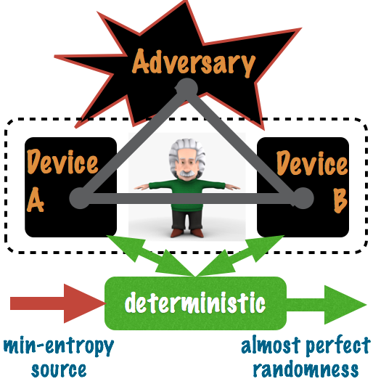
Untrusted-Device Extractor: A Unifying Framework [Chung-Shi-Wu’14]
Adversary: all powerful
prepares/may entangle with device
can’t talk to/change device after protocol starts
Device: multi-component
User: deterministic
can restrict communication among device components
Min-entropy source: necessary; otherwise Adversary can cheat

Slide 18
Expansion and amplification as UD Extractors
Expansion: seeded extraction
Classical source = uniform
Amplification: seedless extraction
Classical source = SV
Flipped view: randomness hidden in Device, not in the source
Classical source is to help catch cheating device

Slide 19
UD Extractors: Goals
Security: quantum
Quality: small errors (completeness
and soundness)
3. Output length: all randomness in
Device
4. Classical source: arbitrary min-entropy
source
Robustness: tolerate a constant noise
Quantum memory: the small the better
Device-efficiency: use the least number of devices
Complexity: computational efficient

Slide 20
New Central Question: How to construct UD extractors with optimal parameters?

Slide 21
Our Results

Slide 22
Randomness Expansion Miller-Shi (2014)
0
0
1
0
0
0
0
0
0
0
1
0
0
0
0
0
An exponential randomness expansion
protocol with full quantum security, and
several new features:
Robustness. (Tolerates constant noise.)
1
1
0
1
0
1
1
1
Based on Coudron, Vidick, Yuen (2013)

Slide 23
Randomness Expansion Miller-Shi (2014)
To be cryptographically secure, i.e. usable for cryptographic applications, the error term must be O(N^{-k}) for all k, where N is the number of rounds.
The significance of this feature was first pointed out by by Chung & Wu.
0
0
1
0
0
0
0
0
0
0
1
0
0
0
0
0
An exponential randomness expansion
protocol with full quantum security, and
several new features:
Robustness. (Tolerates constant noise.)
Cryptographic security.
1
1
0
1
0
1
1
1
Based on Coudron, Vidick, Yuen (2013)

Slide 24
Seeded UD Extractor (Randomness Expansion) Miller-Shi (2014)
We allow communication in between rounds (which many other protocols do not). So, entanglement can be established on-the-fly.
0
0
1
0
0
0
0
0
0
0
1
0
0
0
0
0
An exponential randomness expansion
protocol with full quantum security, and
several new features:
Robustness. (Tolerates constant noise.)
Cryptographic security.
Constant quantum memory. (1 qubit/device.)
1
1
0
1
0
1
1
1
Based on Coudron, Vidick, Yuen (2013)

Slide 25
Seeded UD Extractor (Randomness Expansion) Miller-Shi (2014)
0
0
1
0
0
0
0
0
0
0
1
0
0
0
0
0
An exponential randomness expansion
protocol with full quantum security, and
several new features:
Robustness. (Tolerates constant noise.)
Cryptographic security.
Constant quantum memory. (1 qubit/device.)
Large class of games allowed.
1
1
0
1
0
1
1
1

Slide 26

Quantum Key Distribution Miller-Shi (2014)
Fully secure. Cryptographic error term.
Requires only a polylog-sized seed.
New.
Modified Miller-Shi
11011 1010010001011101010001011101101010001111111010100010 ….
011011100…
010011101…

Slide 27
Example of parameters achievable in Miller-Shi
Input bits = Θ(k)
Output bits ≈ #Rounds = exp(k^{1/6})
Errors = exp(-k^{1/3}) = exp(- log² (#Rounds))
Expansion and key distribution same order of parameters

Slide 28

Seedless UD Extractor (Randomness Amplification) Chung-Shi-Wu (2014)
Uses a single and arbitrary min-entropy source
Minimum assumption on classical source
More general model for weak randomness in our physical world
Secure, robust composition of UD protocols
Any expansion protocol can be used as the
sub-protocol
Allows source/device correlation, and public
seed.
…
…

Slide 29
Example of parameters achievable in Chung-Shi-Wu
Classical source: (n, n^{.01})-source
Output bits = n¹⁰⁰
Soundness error = n⁻¹⁰⁰⁰
Completeness error = exp(-n^{-.004})
Devices and run time poly(n)

Slide 30
Robust Unbounded Expansion Using 2 Devices
Different randomness expansion protocols can not only be composed, but interleaved.
The result is unbounded expansion from any min-entropy source.
Miller-
Shi
Miller-
Shi

Slide 31
Robust Unbounded Expansion Using 2 Devices
Why does this work?
A randomness expansion protocol may be given a seed X that is correlated with some external information Y.
The Equivalence Lemma (CSW) says that as long as X is uniformly random conditioned on the devices, the protocol will still work. Z is independent of Y.
Different randomness expansion protocols can not only be composed, but interleaved.
The result is unbounded expansion from any min-entropy source.
X
Miller-Shi
Z
Y
Miller-
Shi
Chung-Shi-Wu
Miller-
Shi

Slide 32
Robust Unbounded Expansion Using 2 Devices
Other randomness amplification and randomness expansion protocols could be substituted here.
Miller-
Shi
Miller-
Shi

Slide 33
Robust Unbounded Expansion Using 2 Devices
Independent work:
Coudron and Yuen (2013) proved that two specific protocols can be composed to achieve (non-robust) unbounded expansion.
Their work and ours are the first to prove secure compositions of UD protocols.
Other randomness amplification and randomness expansion protocols could be substituted here.
Miller-
Shi
Miller-
Shi

Slide 34
Robust Unbounded Expansion from any min-entropy source
Different randomness expansion protocols can not only be composed, but interleaved.
(n, k)-source → arbitrarily long output, example parameters:
Any n=exp(O(k^{1/2})), any ε=exp(-O(k^{1/2}))
Constant noise, #devices = exp(log²n/ε)
Chung-Shi-Wu
Miller-
Shi
Miller-
Shi

Slide 35
Miller, Shi (2014) Robust Exponential Randomness Expansion with Full Security

Slide 36
Seeded UD Extractor (Randomness Expansion) Miller-Shi (2014)
0
0
1
0
0
0
0
0
0
0
1
0
0
0
0
0
An exponential randomness expansion
protocol with full quantum security, and
several new features:
Robustness. (Tolerates constant noise.)
Cryptographic security.
Constant quantum memory. (1 qubit/device.)
Large class of games allowed.
1
1
0
1
0
1
1
1

Slide 37
Randomness Expansion
Protocol R (from Coudron, Vidick, Yuen 2013)
InputsThe CHSH Game
O₁Å O₂ = 1
0Opt classical score: 1/2
+Opt quantum score: √2/2
-1
01
+1
-1
10
+1
-1
11
-1
+1
Run the device N times. During “game rounds,” play the CHSH game. Otherwise, just input (0,0).
If the average score during game rounds was < √2/2 − C, abort.
(C = “noise tolerance”.)
3. Otherwise, output the bits
produced.
0
0
1
0
0
0
0
0
0
0
0
0
0
1
0
0
0
0
0
1
0
0
[Several authors]: Security proof against an unentangled adversary.
Small resources, high rate
Inputs | Score if O₁⊕ O₂ = 0 | Score if O₁⊕ O₂ = 1
00 | +1 | -1
01 | +1 | -1
10 | +1 | -1
11 | -1 | +1
Game rounds occur
with probability
q. (Small.)
Not fully secure
1
1
0
1
0
1
1
1
11011 1010010001011101010001011101101010001111111010100010 ….

Slide 38
Randomness Expansion
Protocol R (from Coudron, Vidick, Yuen 2013)
Run the device N times. During “game rounds,” play the CHSH game. Otherwise, just input (0,0).
If the average score during game rounds was < √2/2 − C, abort.
(C = “noise tolerance”.)
3. Otherwise, output the bits
produced.
Is this quantum-secure?
0
0
1
0
0
0
0
0
0
0
0
0
0
1
0
0
0
0
0
1
0
0
[Several authors]: Security proof against an unentangled adversary.
Small resources, high rate
Game rounds occur
with probability
q. (Small.)
Not fully secure
1
1
0
1
0
1
1
1
11011 1010010001011101010001011101101010001111111010100010 ….

Slide 39

Finding the pieces to the puzzle…
Self-Testing
Measure
of
Randomness
Uncertainty
Principle
Bound on
Smooth
Min-entropy
Handling
Device
failures
Simulating
Trusted
Measurements

Slide 40
Handling Device Failures
Randomness expansion protocols typically have an all-or-nothing “success” event. This global condition can be hard to manage. It is sometimes easier to work with a local (one-shot) condition.
11011 1010010001011101010001011101101010001111111010100010 ….

Slide 41
Randomness Expansion
Protocol R
Run the device N times. During “game rounds,” play the CHSH game. Otherwise, just input (0,0).
If the average score during game rounds was < √2/2 − C, abort.
(C = “noise tolerance”.)
3. Otherwise, output the bits
produced.
0
0
1
0
0
0
0
0
0
0
0
0
0
1
0
0
0
0
0
1
0
0
[Several authors]: Security proof against an unentangled adversary.
Small resources, high rate
Game rounds occur
with probability
q. (Small.)
Not fully secure
1
1
0
1
0
1
1
1
11011 1010010001011101010001011101101010001111111010100010 ….

Slide 42
Randomness Expansion
Modified Protocol R
The IDS-LE Rule
“If at first you Don’t Succeed,
Lower your Expectations.”
Run the device N times. During “game rounds,” play the CHSH game. Otherwise, just input (0,0).
Whenever the device fails, Bob flips X coins and adds the result to his output.
3. Otherwise, output the bits
produced.
0
0
1
0
0
0
0
0
0
0
0
0
0
1
0
0
0
0
0
1
0
0
[Several authors]: Security proof against an unentangled adversary.
Small resources, high rate
Game rounds occur
with probability
q. (Small.)
Not fully secure
1
1
0
1
0
1
1
1
11011 1010010001011101010001011101101010001111111010100010 ….

Slide 43
Randomness Expansion
Modified Protocol R
Run the device N times. During “game rounds,” play the CHSH game. Otherwise, just input (0,0).
Whenever the device fails, Bob flips X coins and adds the result to his output.
3. Otherwise, output the bits
produced.
0
0
1
0
0
0
0
0
0
0
0
0
0
1
0
0
0
0
0
1
0
0
[Several authors]: Security proof against an unentangled adversary.
Small resources, high rate
Game rounds occur
with probability
q. (Small.)
Not fully secure
1
1
0
1
0
1
1
1
11011 1010010001011101010001011101101010001111111010100010 ….

Slide 44
Robust Self-Testing
Some non-local games have the property that there is only one optimal quantum strategy, of which all near-optimal strategies are simply approximations. [McKague-Scarani-Yang, Miller-Shi, Reichardt-Unger-Vazirani, …] CHSH is an example.
0
1
0
0
1
…
1
1
1
1
0
…
11011 1010010001011101010001011101101010001111111010100010 ….

Slide 45
Self-Testing
C. Miller, Y. Shi. “Optimal robust self-testing by binary nonlocal XOR games.” arXiv:1207.1819. (2013)
A characterization of all “strong self-tests” from the class of binary XOR games. (Includes CHSH.)
(Is the self-testing property enough to deduce robust randomness expansion? Maybe, but I’ve never figured out how.)
11011 1010010001011101010001011101101010001111111010100010 ….

Slide 46
Trusted Measurement Devices
Say that a binary device is a trusted measurement device if it is guaranteed to generate its outputs from anti-commuting measurements.
11011 1010010001011101010001011101101010001111111010100010 ….

Slide 47
Trusted Measurement Devices
Say that a binary device is a trusted measurement device if it is guaranteed to generate its outputs from anti-commuting measurements. (State is unknown—could be entangled.)
11011 1010010001011101010001011101101010001111111010100010 ….

Slide 48
Simulating Trusted Measurements
We can force untrusted devices to perform partially trusted measurements!
Choose a strong self-test G.
On input 1, play the game.
On input 0, just feed “0” to the
1st component and pass
along its output.
l
11011 1010010001011101010001011101101010001111111010100010 ….

Slide 49
Simulating Trusted Measurements
We can force untrusted devices to perform partially trusted measurements!
Theorem: This device simulates
a device with partially trusted
measurements.
l
11011 1010010001011101010001011101101010001111111010100010 ….

Slide 50
Simulating Trusted Measurements
We can force untrusted devices to perform partially trusted measurements!
Theorem: This device simulates
a device with partially trusted
measurements.
Prob v: Do anti-
commuting msrmts
Prob h: flip a coin.
Prob (1-v-h): Do an
unknown msrmt.
11011 1010010001011101010001011101101010001111111010100010 ….

Slide 51
Simulating Trusted Measurements
We can force untrusted devices to perform partially trusted measurements!
Proof idea: If the untrusted devices
win G w/ sub-optimal probability,
this is easy to prove. If they win
with near optimal probability,
the theory of Miller-Shi 2013
gives the result.
Prob v: Do anti-
commuting msrmts
Prob h: flip a coin.
Prob (1-v-h): Do an
unknown msrmt.
11011 1010010001011101010001011101101010001111111010100010 ….

Slide 52
Simulating Trusted Measurements
We can force untrusted devices to perform partially trusted measurements!
Question: Can the result be
generalized to non-self-tests?
Prob v: Do anti-
commuting msrmts
Prob h: flip a coin.
Prob (1-v-h): Do an
unknown msrmt.
11011 1010010001011101010001011101101010001111111010100010 ….

Slide 53
Finding the pieces to the puzzle…
Self-Testing
Measure
of
Randomness
Uncertainty
Principle
Bound on
Smooth
Min-entropy
Handling
Device
failures
Simulating
Trusted
Measurements

Slide 54
The right measure of randomness
How do we measure the randomness
of the protocol, in terms of the joint
state Γ of the inputs, outputs, and
adversary?
0
0
1
0
0
0
0
0
0
0
0
Prob v: Do anti-
commuting msrmts
Prob h: flip a coin.
Prob (1-v-h): Do an
unknown msrmt.
Device with
trusted measurements
1
1
0
1
11011 1010010001011101010001011101101010001111111010100010 ….

Slide 55
The right measure of randomness
Min-entropy?
Smooth min-entropy?
The trace of the square
of Γ ?
Collision entropy?
Too sharp—doesn’t work.
Too complex.
Better—works for
max. entangled case.
Even better. But
not good for small q.
0
0
1
0
0
0
0
0
0
0
0
Prob v: Do anti-
commuting msrmts
Prob h: flip a coin.
Prob (1-v-h): Do an
unknown msrmt.
1
1
0
1
11011 1010010001011101010001011101101010001111111010100010 ….

Slide 56
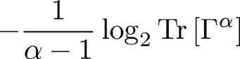
The right measure of randomness
α-Renyi entropy,
with α=1+Κq.
(a la Jaksic et al. 2011, Mueller-Lennert et al. 2013,
Wilde et al. 2013)
In the maximally entangled case, this is simply
Perfect.
0
0
1
0
0
0
0
0
0
0
0
1
1
0
1
11011 1010010001011101010001011101101010001111111010100010 ….

Slide 57
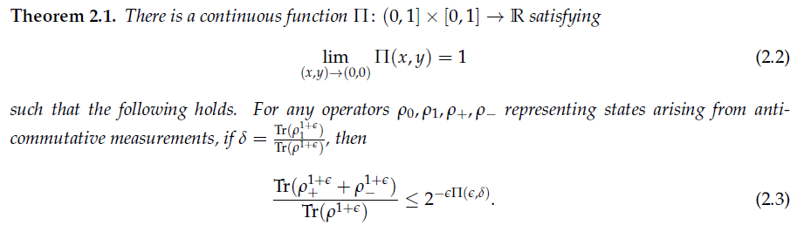
An Uncertainty Principle (The Flux Capacitor)
Prob v: Do anti-
commuting msrmts
Prob h: flip a coin.
Prob (1-v-h): Do an
unknown msrmt.
Basically, this says that the output of 1 iteration of Protocol R is random.
11011 1010010001011101010001011101101010001111111010100010 ….

Slide 58

An Uncertainty Principle (The Flux Capacitor)
“This! This is what makes time travel possible. The flux capacitor.”
Prob v: Do anti-
commuting msrmts
Prob h: flip a coin.
Prob (1-v-h): Do an
unknown msrmt.
Basically, this says that the output of 1 iteration of Protocol R is random.
11011 1010010001011101010001011101101010001111111010100010 ….

Slide 59
Putting it all together
The Uncertainty Principle implies that the Renyi entropy increases linearly across rounds.
Renyi entropy implies a lower bound on the number of extractable bits (provided α is not too close to 1).
This completes the proof!
Prob v: Do anti-
commuting msrmts
Prob h: flip a coin.
Prob (1-v-h): Do an
unknown msrmt.
11011 1010010001011101010001011101101010001111111010100010 ….

Slide 60
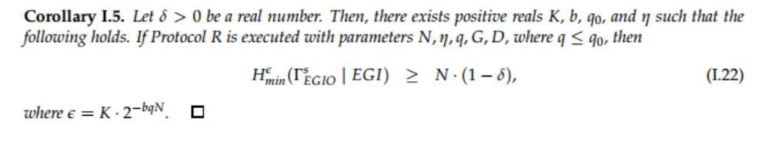
Putting it all together
Protocol R is quantum-secure.
Prob v: Do anti-
commuting msrmts
Prob h: flip a coin.
Prob (1-v-h): Do an
unknown msrmt.
11011 1010010001011101010001011101101010001111111010100010 ….

Slide 61
Quantum Key Distribution
Alice and Bob perform Protocol R, and then flip bits according to inputs in order to get correlated keys.
The work that completes the proof is information reconciliation with small seed.
Modified Miller-Shi
11011 1010010001011101010001011101101010001111111010100010 ….
011011100…
010011101…

Slide 62
Chung, Shi, Wu (2014) Seedless Untrusted- Device Randomness Extraction

Slide 63
Seedless UD Extractor (Randomness Amplification) Chung-Shi-Wu (2014)
Uses a single and arbitrary min-entropy source
Minimum assumption on classical source
More general model for weak randomness in our physical world
Secure, robust composition of UD protocols
Any expansion protocol can be used as the
sub-protocol
Allows source/device correlation, and public
seed.
…
…

Slide 64
Creating the CSW Protocol
A starting point: quantum-proof randomness extractors. (E.g., De et al. (2012).)
11011 1010010001011101010001011101101010001111111010100010 ….

Slide 65
Creating the CSW Protocol
A starting point: quantum-proof randomness extractors. (E.g., De et al. (2012).)
classical
11011 1010010001011101010001011101101010001111111010100010 ….

Slide 66
Creating the CSW Protocol
If Bob had an additional uniform seed, he could carry out extraction.
classical
11011 1010010001011101010001011101101010001111111010100010 ….

Slide 67
Creating the CSW Protocol
If Bob had an additional uniform seed, he could carry out extraction. But he doesn’t.
classical
11011 1010010001011101010001011101101010001111111010100010 ….

Slide 68
Creating the CSW Protocol
So instead, he tries out all possible values for the seed.
At least one of the outputs must be (nearly) uniform.
( ‘s are copies of one another.)
0
1
2
N
…
RE
RE
RE
RE
classical
11011 1010010001011101010001011101101010001111111010100010 ….

Slide 69
Quantum Somewhere Randomness
A new analogue of a classical concept.
A sequence of random variables
X₀ , X₁ , X₂ , … X_{N}
is a quantum somewhere random source (against system E) if there exists i such that X_{i} has a uniform distribution (with respect to E).

Slide 70
Decoupling
0
At least one of the
outputs is (nearly)
uniformly random.
How do we get to it?
Challenge: There may
be correlations.
1
2
N
…
RE
RE
RE
RE
classical
X₀
X₁
X₂
X_{N}
11011 1010010001011101010001011101101010001111111010100010 ….

Slide 71
Decoupling
0
We need a procedure
that will break correlations
with X_{i}.
1
2
N
…
RE
RE
RE
RE
classical
X₀
X₁
X₂
X_{N}
11011 1010010001011101010001011101101010001111111010100010 ….

Slide 72
Decoupling
0
We need a procedure
that will break correlations
with X_{i}. Then it will
be easy to finish the
protocol.
1
2
N
…
RE
RE
RE
RE
classical
?
?
?
?
Bitwise XOR
11011 1010010001011101010001011101101010001111111010100010 ….

Slide 73
Decoupling
0
Fortunately by the
Equivalence Lemma,
Miller-Shi does just that.
1
2
N
…
RE
RE
RE
RE
classical
X₀
X₁
X₂
X_{N}
11011 1010010001011101010001011101101010001111111010100010 ….

Slide 74
Decoupling
0
Fortunately by the
Equivalence Lemma,
Miller-Shi does just that.
If the marginal distribution
of a seed is uniform,
then its output is globally
random.
1
2
N
…
RE
RE
RE
RE
classical
Miller-
Shi
Miller-
Shi
Miller-
Shi
Miller-
Shi
11011 1010010001011101010001011101101010001111111010100010 ….

Slide 75
Decoupling
0
Success! Uniformly
random output.
(Note: The number of
devices could be too
large to be efficient—
room for improvement!)
1
2
N
…
RE
RE
RE
RE
classical
Miller-
Shi
Miller-
Shi
Miller-
Shi
Miller-
Shi
Bitwise XOR
11011 1010010001011101010001011101101010001111111010100010 ….

Slide 76
Further Directions

Slide 77
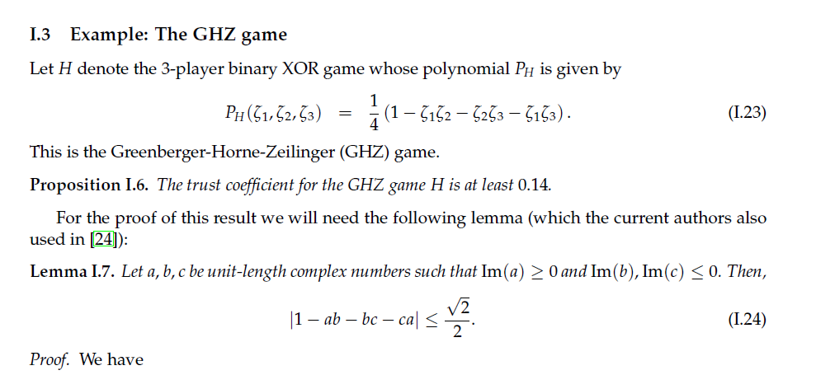
A Challenge
Find the nonlocal games which optimize the noise-tolerance for Miller-Shi 2014.
(Section I.3 in
arXiv:1402.0489.)
This part of the paper is very preliminary—improve it!

Slide 78
The Dream: A Perfect Untrusted-Device Extractor
Find a randomness amplification protocol with all of the following:
* Arbitrary min-entropy source.
* A constant number of device components.
* Cryptographic security.
* Robustness.
* Constant quantum memory.
* Exponential expansion.

Slide 79

Other species of physical extractors?
Allow “physical sources”
Base security of the validity of physical theory
Any different systems than untrusted q. devices?

Slide 80
Special thanks to
Brett Hemenway
Thomas Vidick
Qi Cheng
Venkatesan Guruswami
Ryan Landay
Evan Noon
and the QIP research group
at the University of Michigan.

